Slide 1
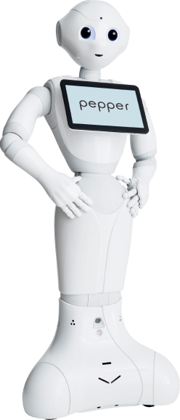
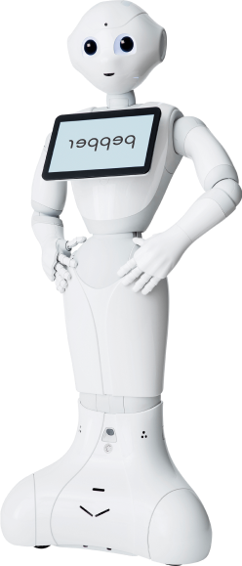
Pepper Pose Mirroring
Tomáš Trejdl, Vojtěch Tilhon
KSY 2021/22, FEL ČVUT

Slide 2
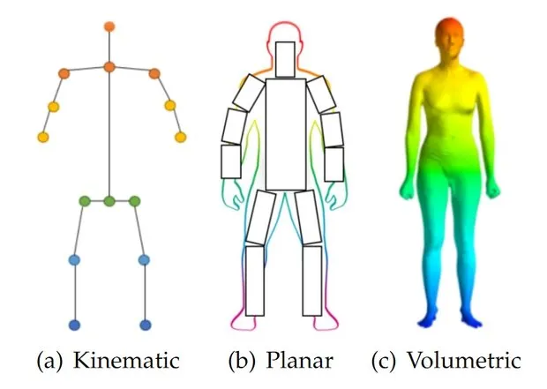
Pose estimation
Using a single 2D RGB camera
For the purpose of mirroring the pose on a robot, kinematic estimation is good enough
Keypoint map directly to robot’s joints

Slide 3
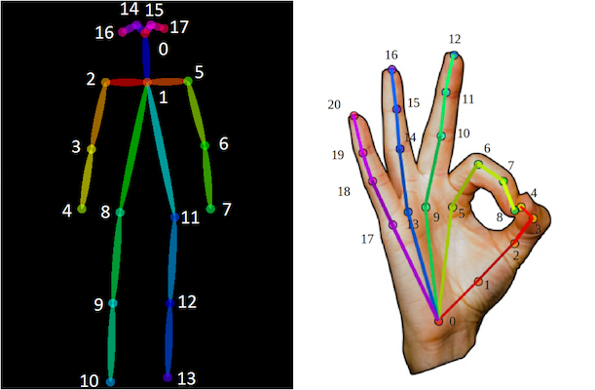
Pose estimation
pytorch-openpose
open-source implementation of OpenPose
Body pose is estimated by 18 keypoints
Each hand is estimated by 21 keypoints

Slide 4
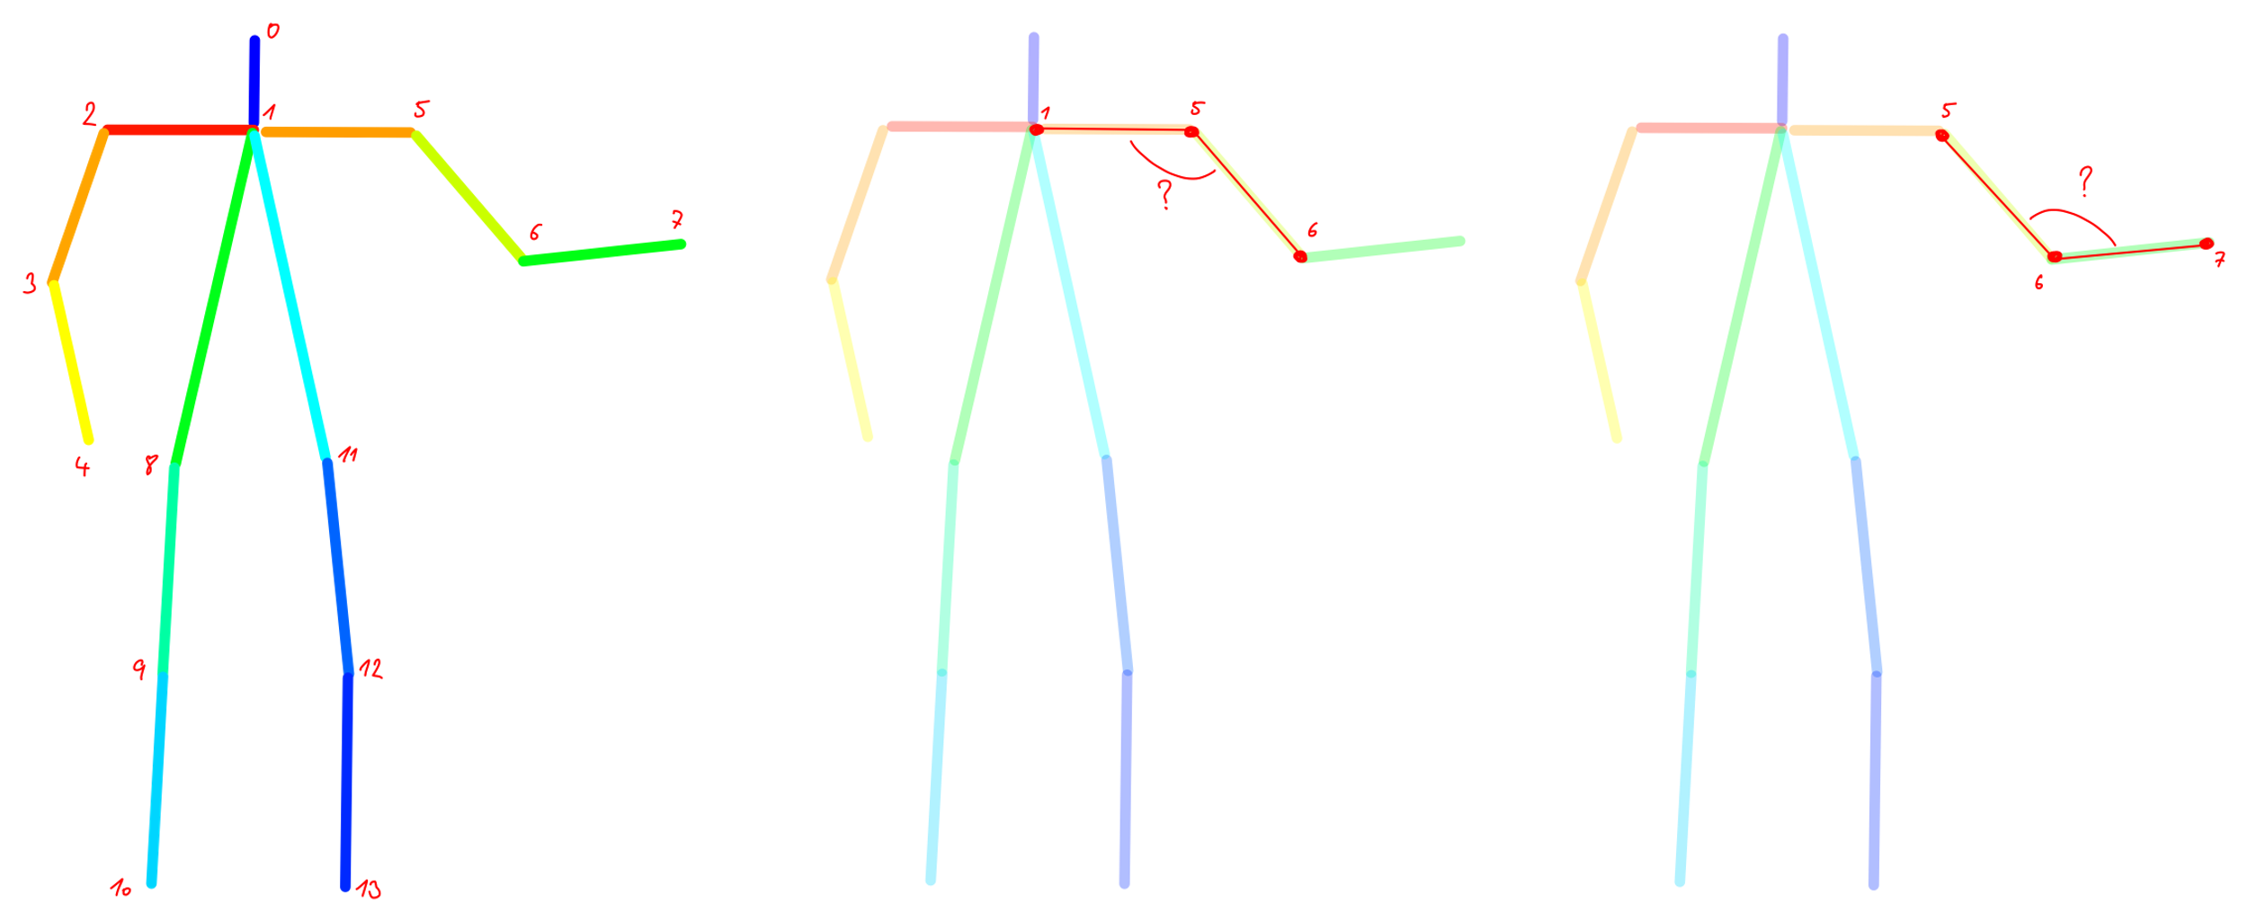
Transforming pose to commands for Pepper
We assume the person is only moving in a 2D plane in parallel with his/her shoulders
We calculate the angle between arm segments in radians and tell Pepper to move his arms to that angle

Slide 5
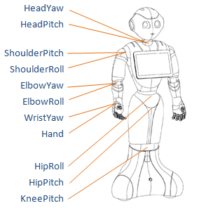
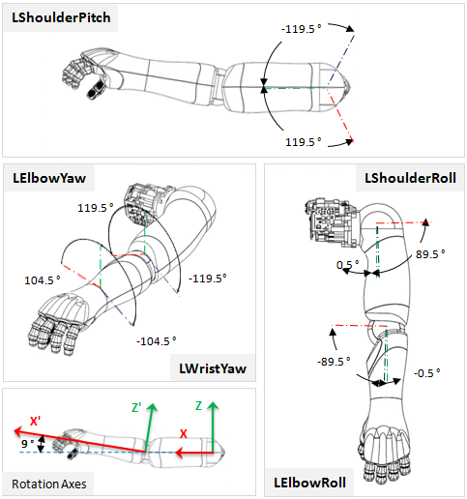
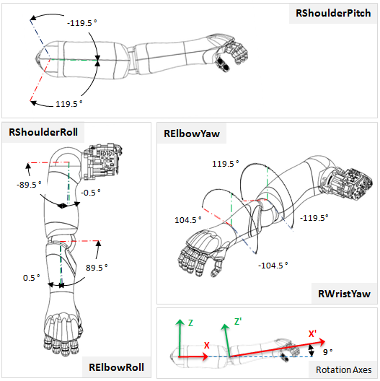
Controlling Pepper
Available commands:
Move joint by angle
Open / close hand

Slide 6
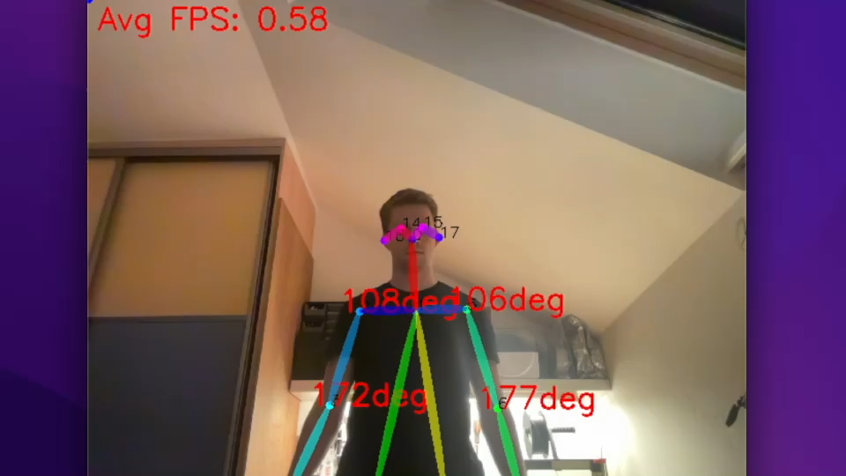
Demo

Slide 7
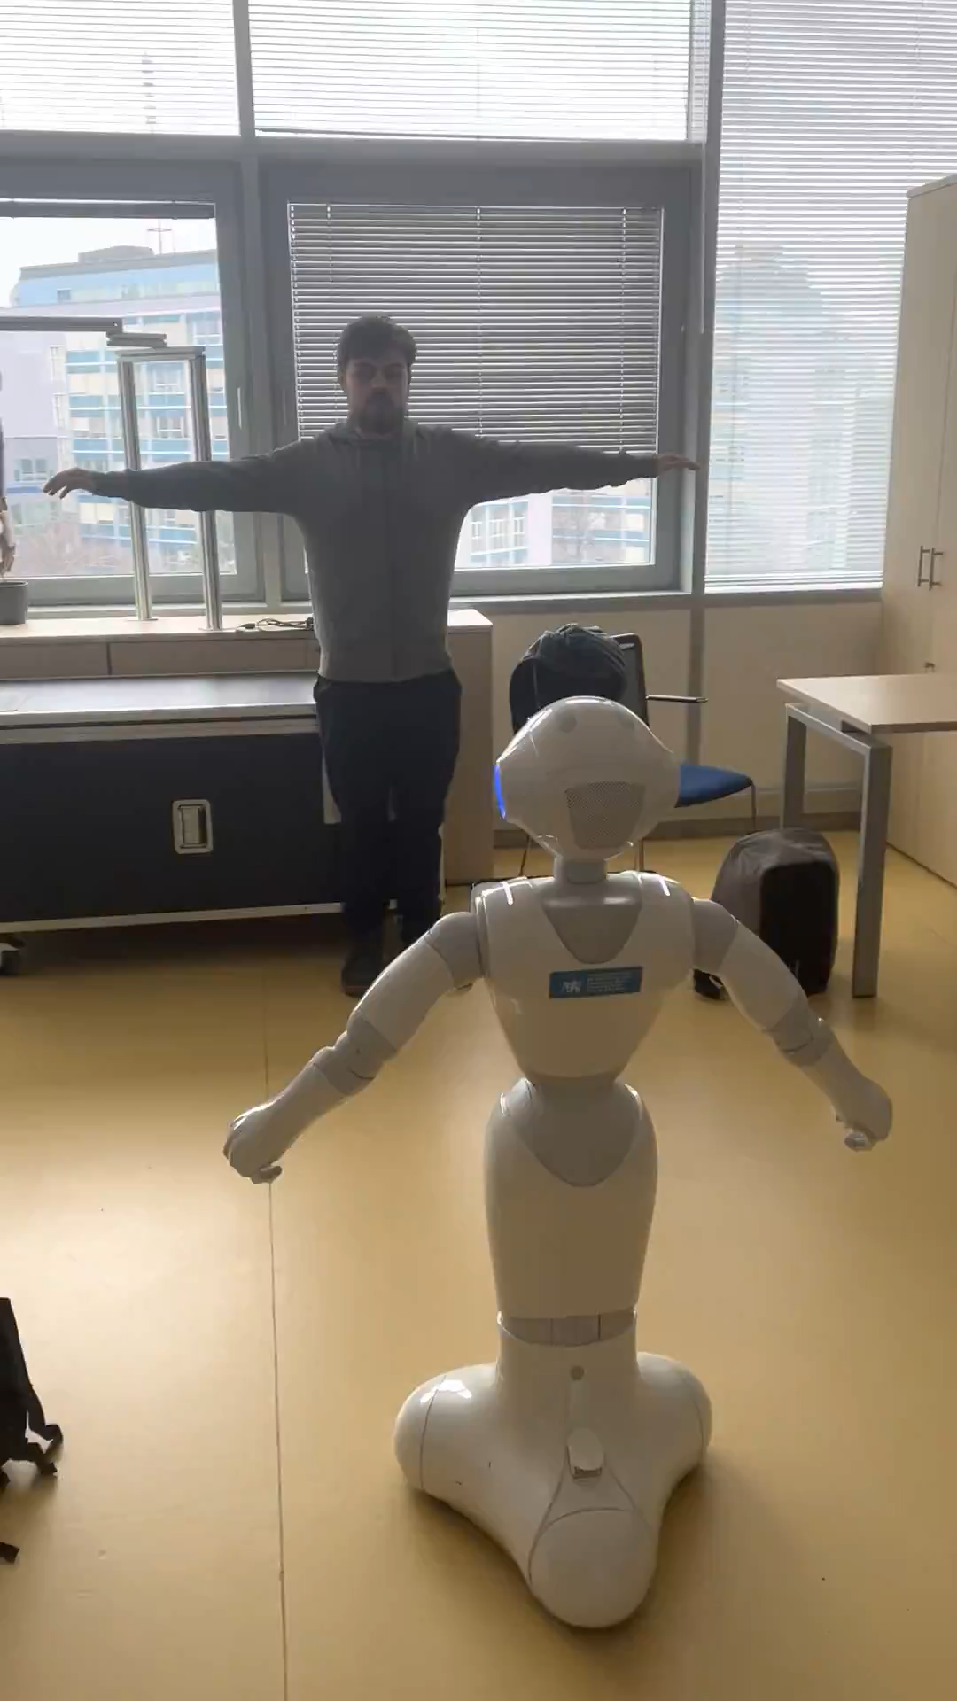
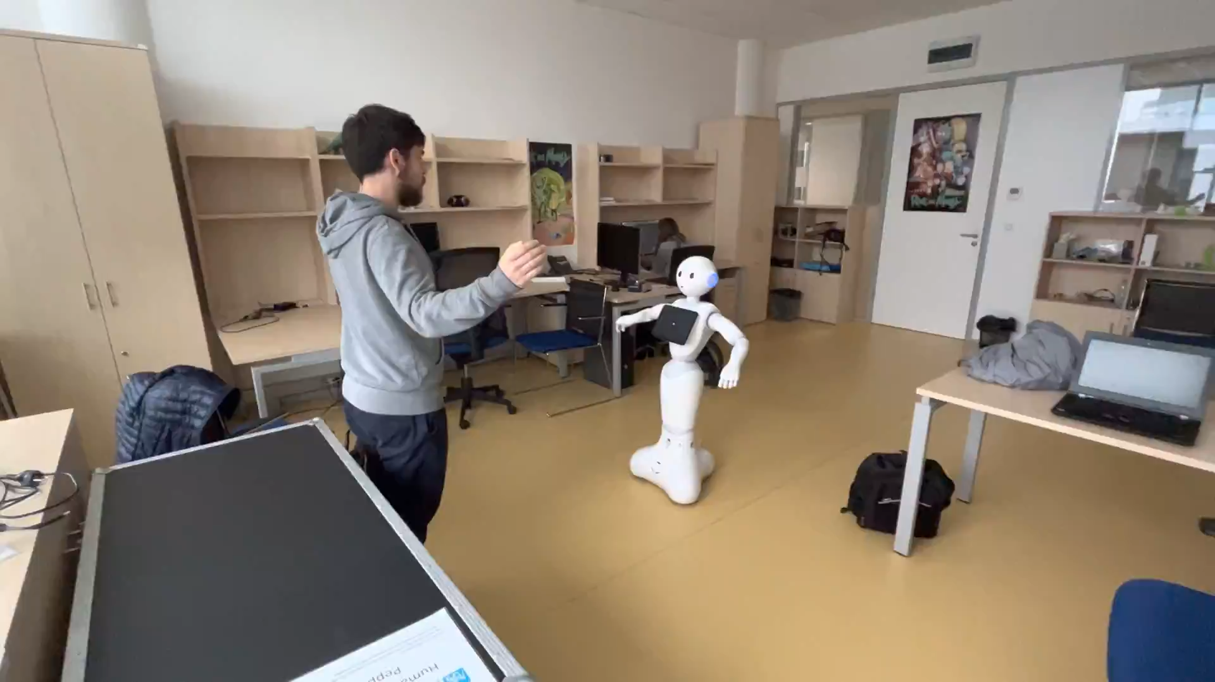
Demo

